Slide 1
The Changing Landscape of Issues and Claims in the National Petition of South Korea, 2017-2020.
Ka Yoon Kim
Department of Sociology, Chung-Ang University
shiaky3821@gmail.com
February 2, 2021

Slide 2
The Number of Petitions per Categories
(Ratio)

Slide 3
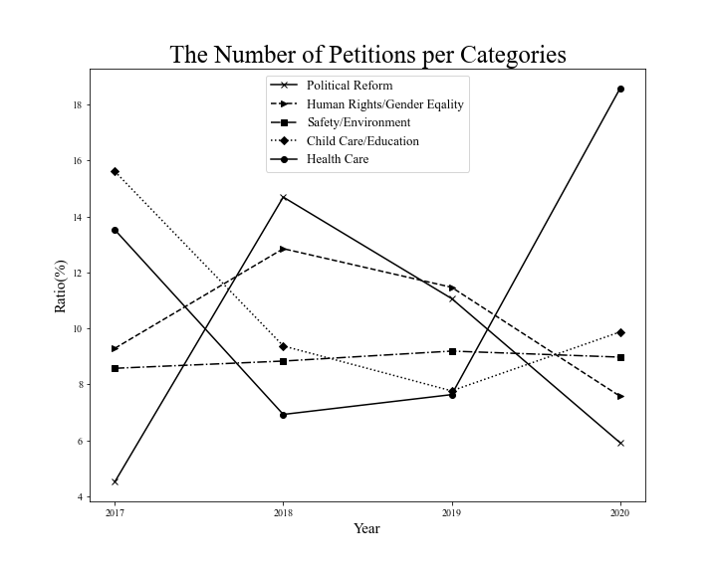

Slide 4
The 10 most-popular Petitions

Slide 5
Rank | Date posted | # of Signatures | Petition title/Subject Matter
1 | 2020-03-18 | 2715626 | Release the personal information of the suspects of Telegram Nth room case and put them on the photographers’ area (criminal case involving blackmail, cybersex trafficking, and the spread of sexually exploitative videos via Telegram)
2 | 2020-03-20 | 2026252 | Release the personal information of all Telegram Nth room subscribers
3 | 2019-04-22 | 1831900 | Dissolution of a certain political party called ‘Jayoo Hankook’
4 | 2020-02-26 | 1504597 | Supporting President Moon Jae-in!
5 | 2020-02-04 | 1469023 | Urging the impeachment of President Moon Jae-in
6 | 2020-02-22 | 1449521 | Dissolution of a certain religious group called ‘Shincheonji’
7 | 2018-10-17 | 1192049 | Perpetrators of heinous crimes should not be given lenient sentences due to their history of mental illnesses
8 | 2020-04-02 | 1007040 | More violent punishment for juvenile delinquents
9 | 2020-01-23 | 761833 | Request of Chinese immigration prohibition
10 | 2019-08-21 | 757730 | Request of an appointment of the certain candidate (Cho Gook) as the Minister of Justice

Slide 6
WordCloud Visualization of
Petition Contents

Slide 7
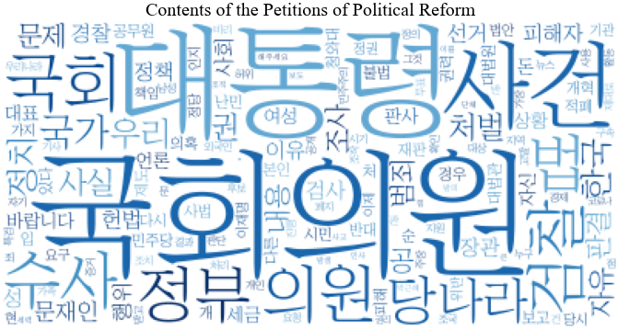



Slide 8
